Slide 1
MACHINE LEARNING
Normalization and Standardization

Slide 2
Feature Scaling
It is a method used to normalize the range of independent variables or features of data. In data processing, it is also known as data normalization and is generally performed during the data preprocessing step.
Also, feature scaling helps ML,DL algorithms train and converge faster.
Techniques
Normalization
Standardization

Slide 3
Some of the Algorithms where we use the concept of feature scaling these are
KNN - K-nearest neighbors (KNN) with a Euclidean distance measure is sensitive to magnitudes and hence should be scaled for all features to weigh in equally.
K Means Clustering
Deep Learning based algorithm etc..

Slide 4
Different Techniques of Feature Scaling
Normalization (Min-Max Scaling)
Standardization (Z-score Normalization)

Slide 5
Normalization (Min-Max Scaling):
It is the process of translating data into the range [0, 1] or simply transforming data onto the unit sphere.
Normalization equation is
new = (x_min) / (x_max - x_min)
This scales the range to [0, 1]
Normalization is also called as min-max scalar.

Slide 6
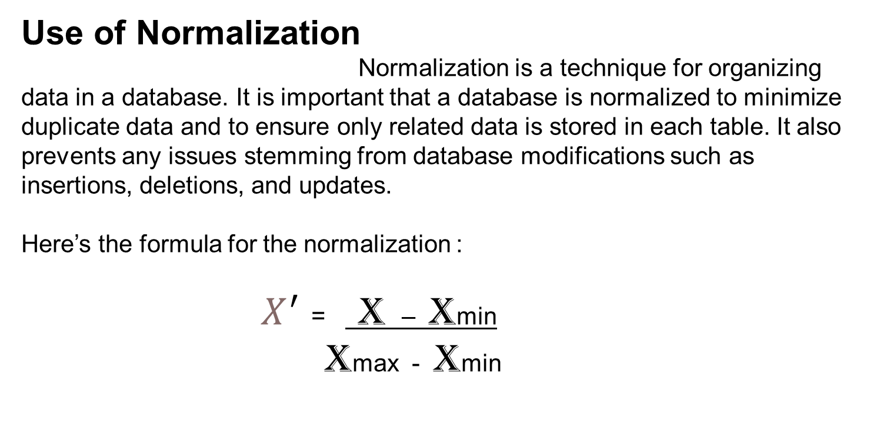
Use of Normalization
Normalization is a technique for organizing data in a database. It is important that a database is normalized to minimize duplicate data and to ensure only related data is stored in each table. It also prevents any issues stemming from database modifications such as insertions, deletions, and updates.
Here’s the formula for the normalization :
$X^{′}$ = X – Xmin
Xmax - Xmin

Slide 7
Standardization (Z-score Normalization)
Standardization is another scaling technique where the values are centered around the mean with a unit standard deviation. This means that the mean of the attribute becomes zero and the resultant distribution has a unit standard deviation.
It helps to scale down feature based on standard normal distribution.
X_new = (X - mean) / Std

Slide 8
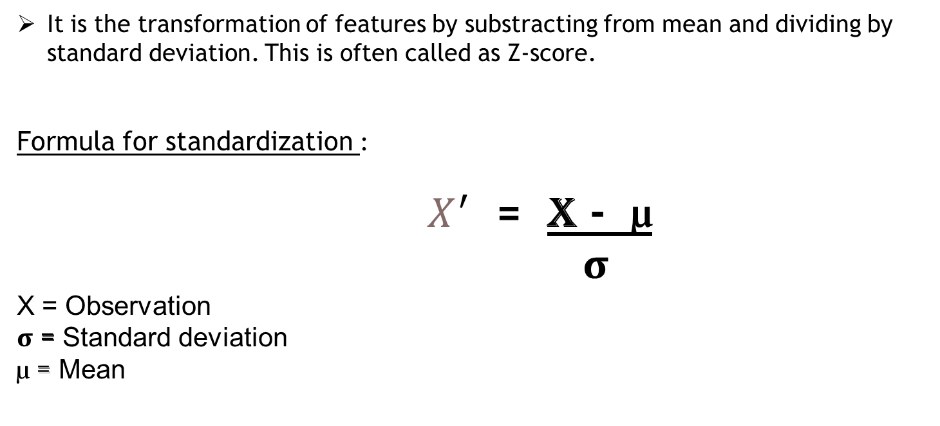
It is the transformation of features by substracting from mean and dividing by standard deviation. This is often called as Z-score.
Formula for standardization :
$X^{′}$ = X - µ
σ
X = Observation
σ = Standard deviation
µ = Mean

